Slide 1


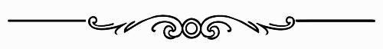
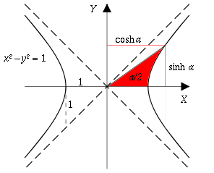
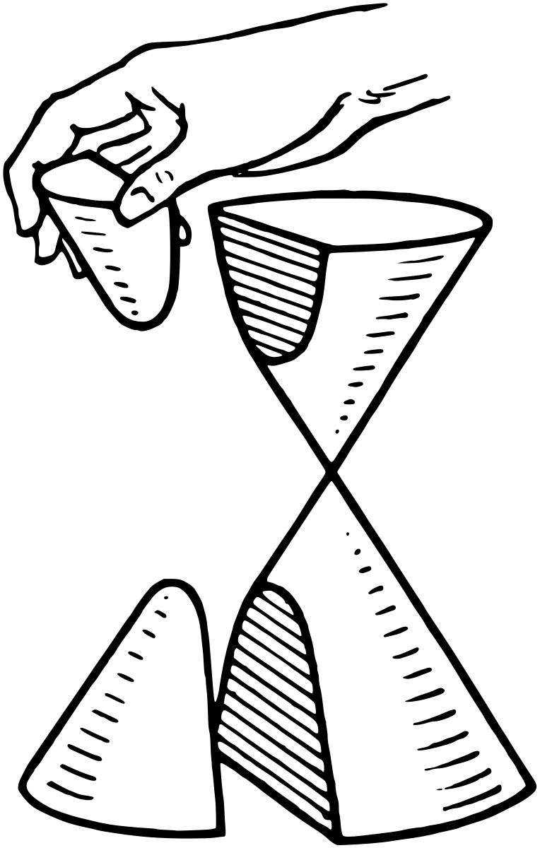
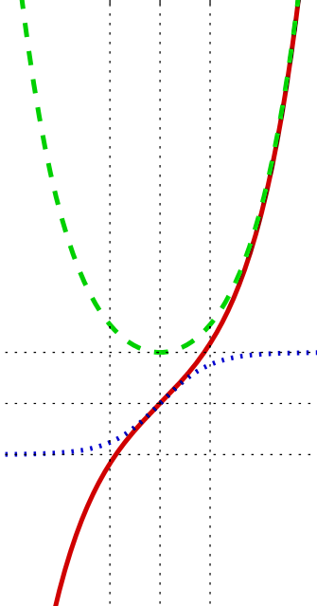
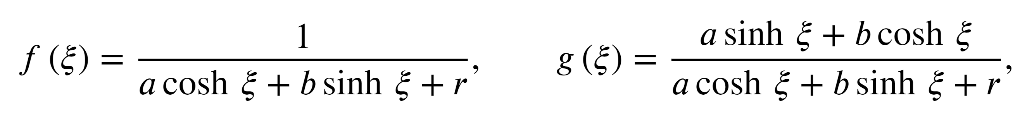

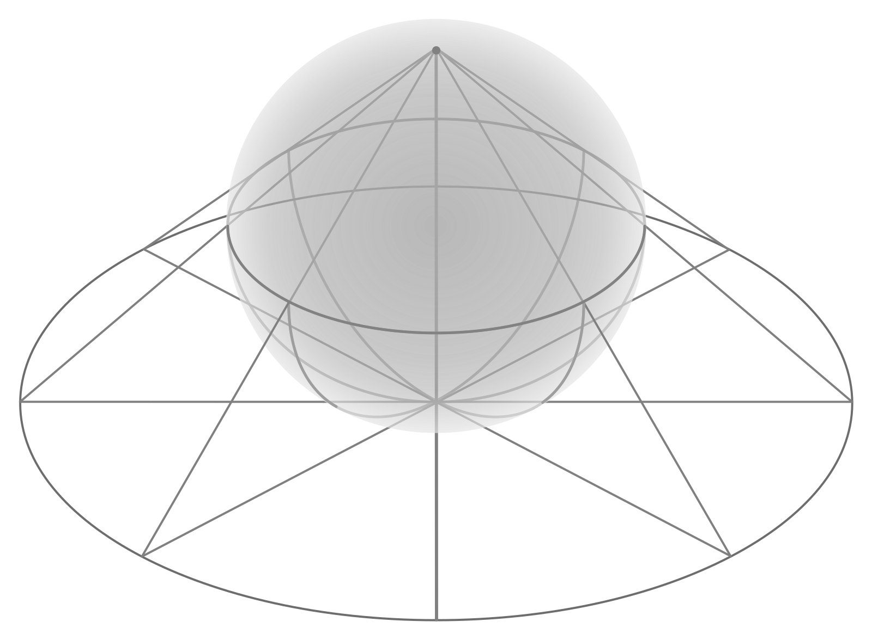
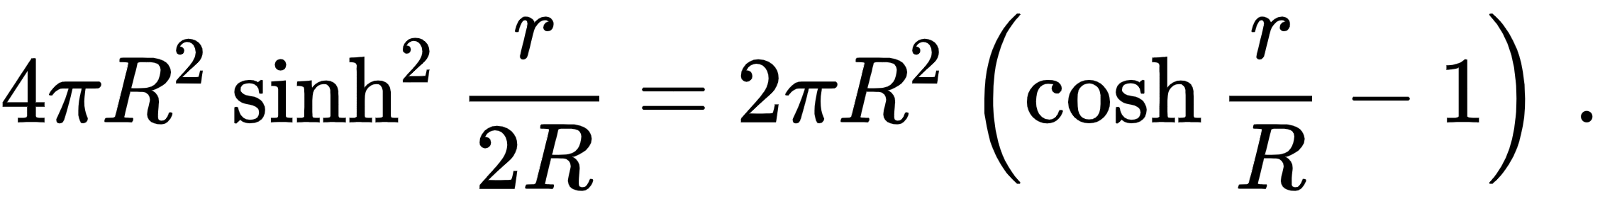
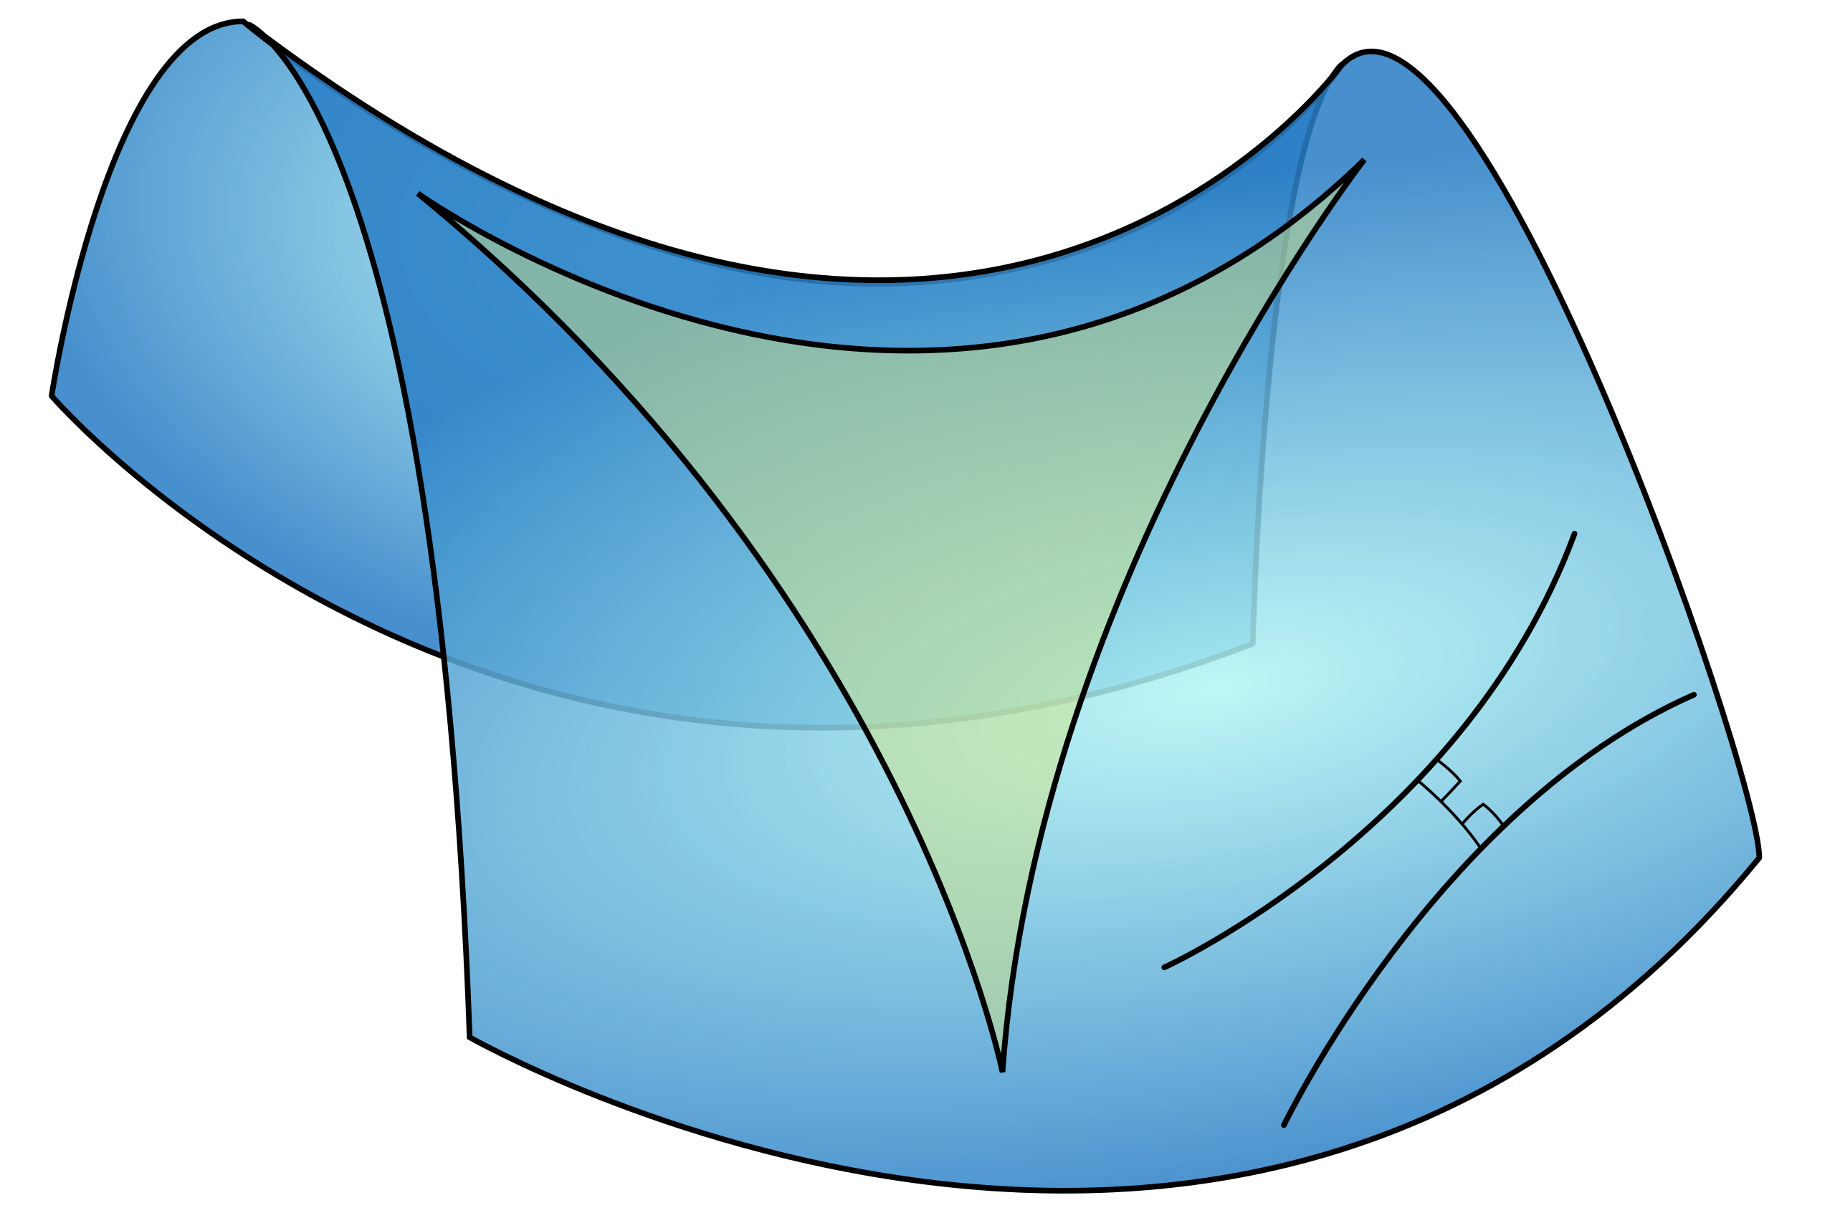
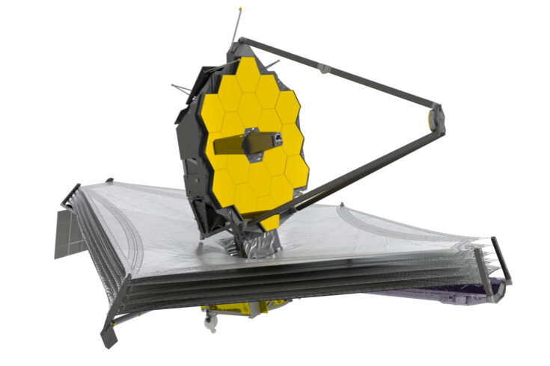
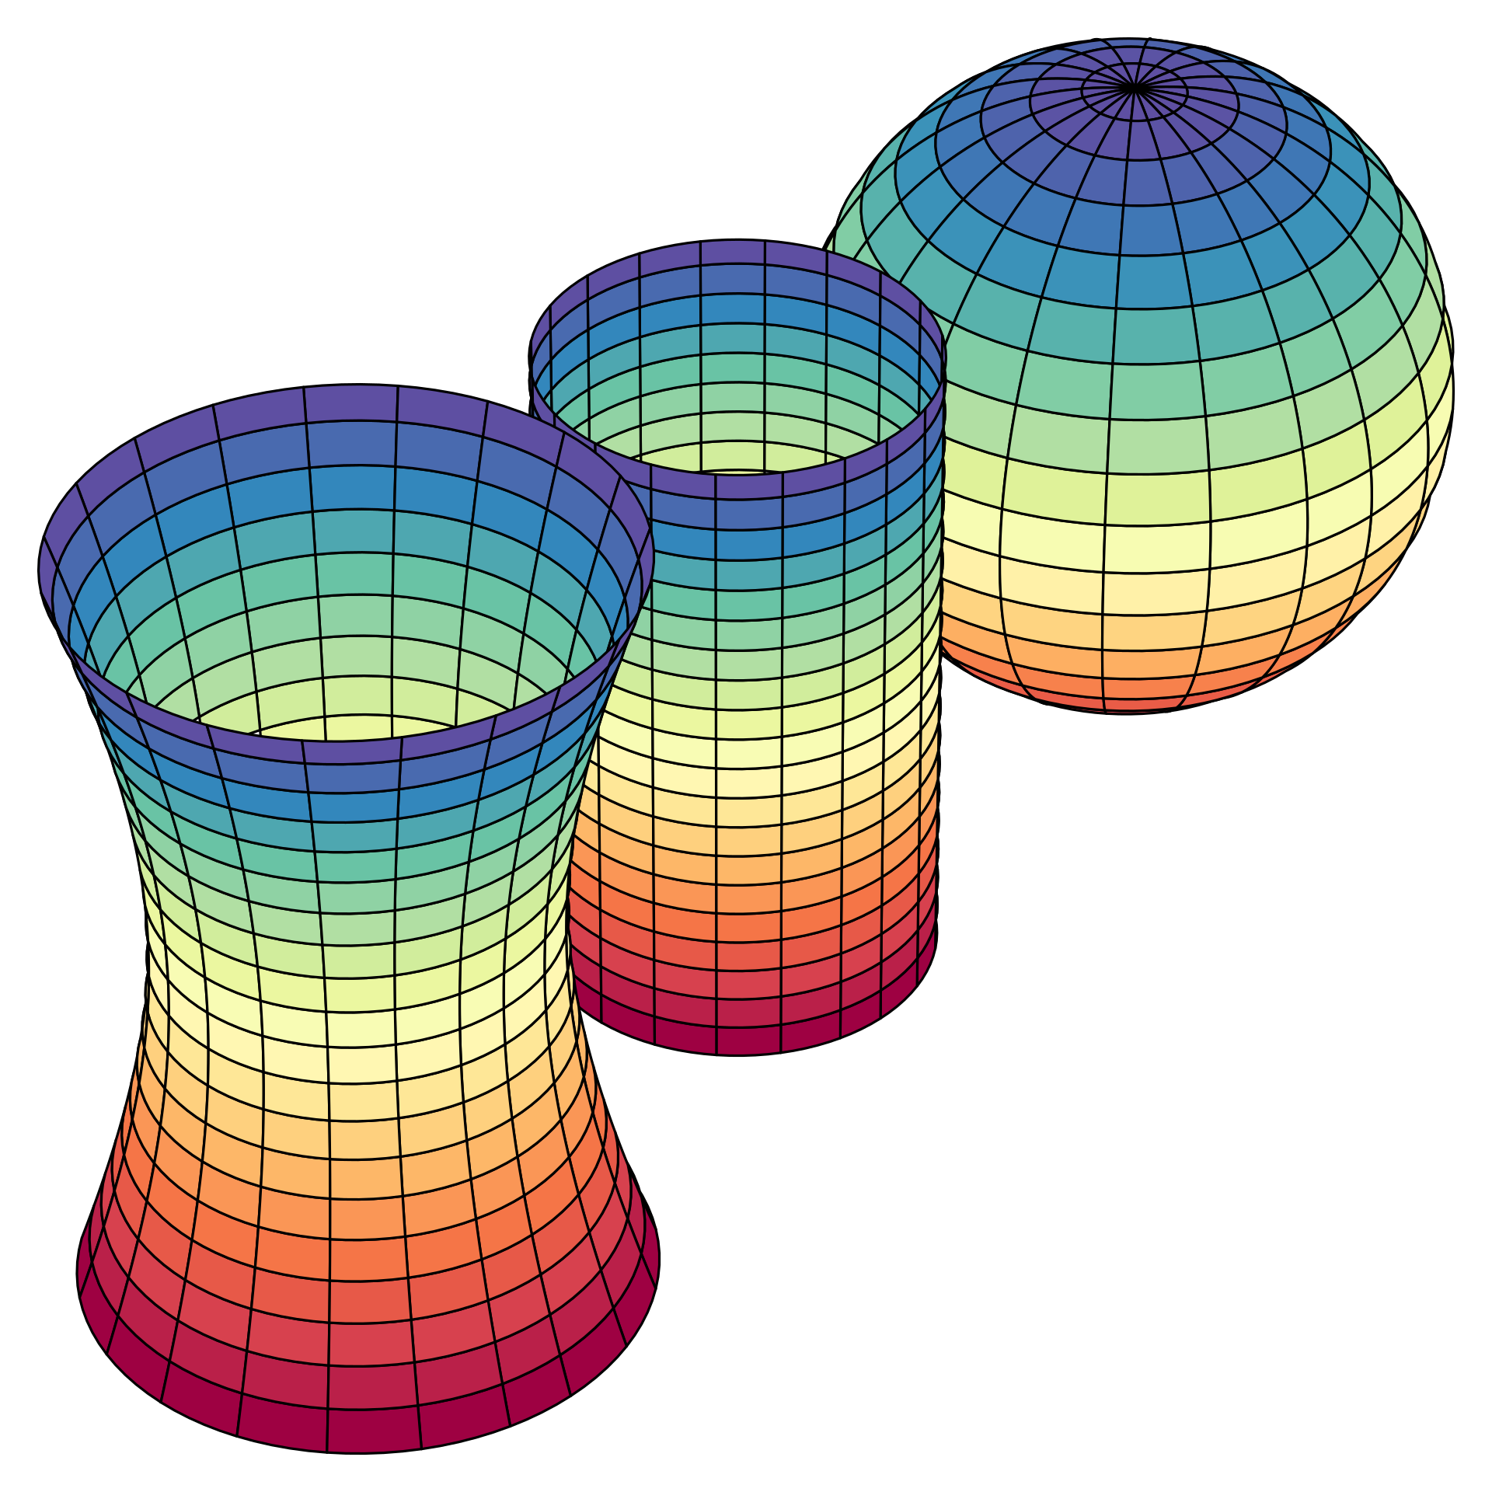
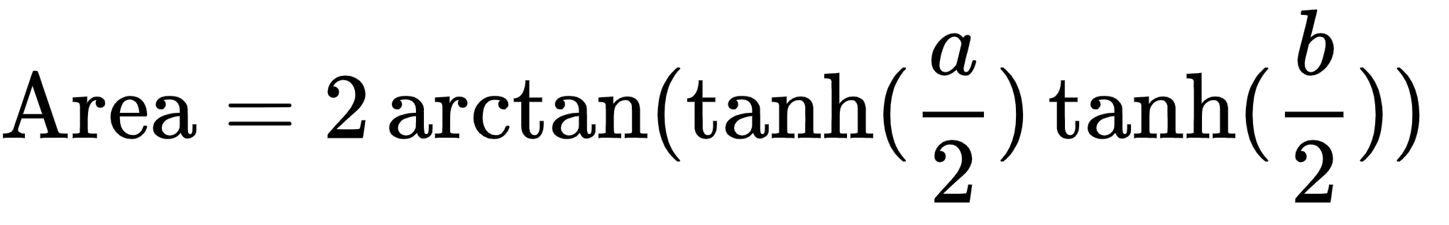
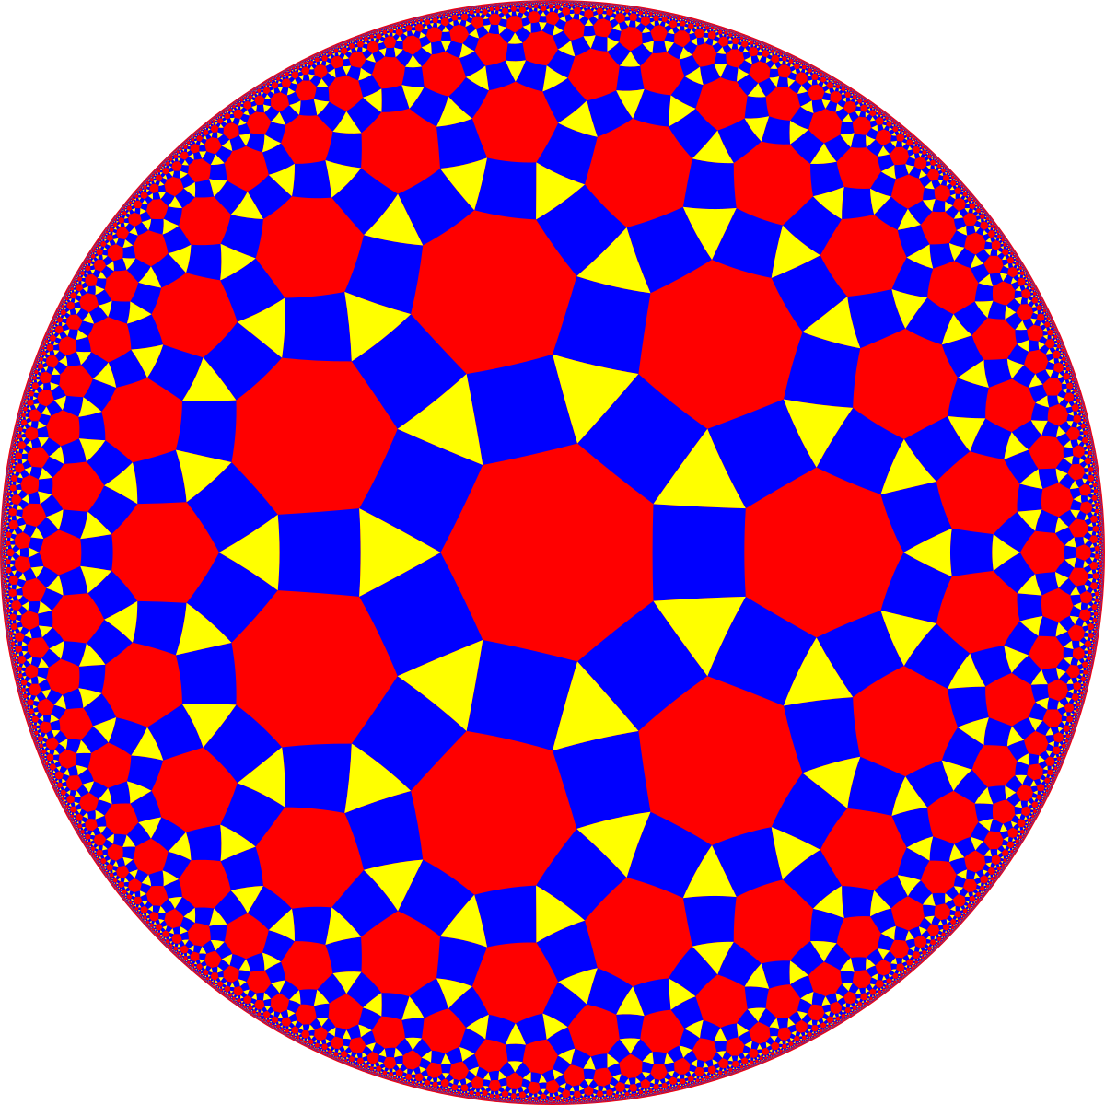
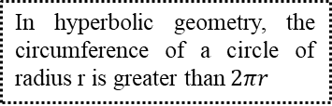

K. J. Somaiya College of Engineering, Mumbai – 400 077
(A Constituent College of Somaiya Vidyavihar University) Dept. of Science and Humanities
F.Y. B. Tech. Semester –I (2020-21)
Applied Mathematics-I
IA-II
Name: Adithe Shivaram
Batch: D2
Branch: ETRX
Roll Number: 16010221024
Geometric Interpretation of Hyperbolic Function
Hyperbola and its functions
Hyperbolic function’s geometrical properties serve in the calculations of angles and distances in hyperbolic geometry. They also occur in the solutions of many linear differential equations, cubic equations, and Laplace's equation which plays a major role in topics of physics like electromagnetic theory, heat transfer, fluid dynamics, and special relativity.
Two mirrored infinite bows called Hyperbola has some functions that are analogues of the ordinary trigonometric functions, but defined using the hyperbola rather than the circle.
The extended hyperbolic function method for generalized forms of nonlinear heat conduction and Huxley equations
Application:
Hyperbolic Geometry:
Circles and disks:
Triangles:
Tessellations:
James Webb Telescope hyperbolic mirrors:
There are an infinite number of uniform tilings based on the Schwarz triangles (p q r) where 1/p + 1/q + 1/r < 1
In hyperbolic geometry, the circumference of a circle of radius r is greater than $2πr$
Hyperbolic plane geometry is the geometry of saddle surfaces and pseudospherical surfaces, surfaces with a constant negative Gaussian curvature
Adjustments in hyperbolic sine and cosine functions play an important role in capturing an image billions of nautical miles away
Planar hyperbolic triangles also describe triangles possible in any higher dimension of hyperbolic spaces.
Gaussian curvature

Slide 2
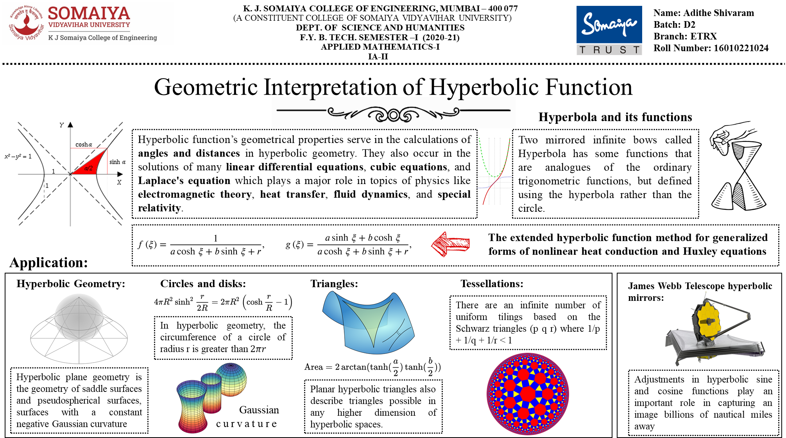

Slide 4

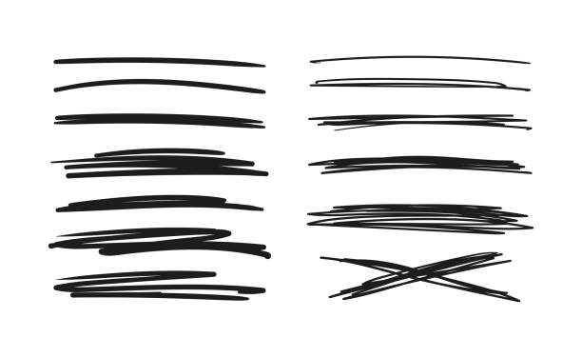
K. J. Somaiya College of Engineering, Mumbai – 400 077
(A Constituent College of Somaiya Vidyavihar University) Dept. of Science and Humanities
F.Y. B. Tech. Semester –I (2020-21)
Applied Mathematics-I
IA-I
Name: Ashuli Chikhale
Batch: D2
Branch: ETRX
Roll Number: 16010221032
Google’s use of eigenvalues and eigenvectors

